Slide 1

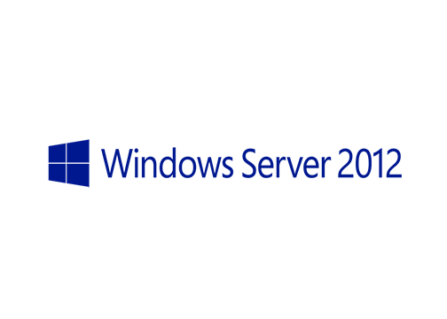
MegaSeries
Install and configure Hyper-V Server 2012

Slide 2
Intro
Specialized version of Windows Server with limited functionality
Has all Hyper-V and related tech functions as the full Windows Server 2012
Does not offer any client licenses
Should be used only as a Hyper-V server
It is FREE!!!

Slide 3
https://www.youtube.com/channel/UCcZ-jLbPwNr8E_v9-65n8Iw https://github.com/itknowledge4

